Slide 1
Big Mountain Resort
Ticket Pricing Executive Presentation

Slide 2
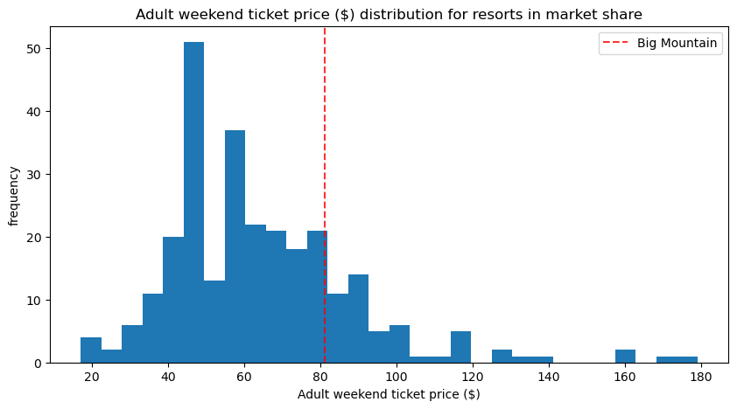
Problem Identification
Background
An additional chair lift was recently installed that will increase operating costs by $1,540,000 in the upcoming season.
The current pricing strategy is to charge a premium above the average price of resorts in the market segment, which may not be capitalizing on facilities as much as it could.
Investment strategy is being hurt by the current pricing model as it is unclear on what facilities are driving revenue.
Several changes are being considered that will hopefully cut costs without undermining the ticket price or will support an even higher ticket price.
Problem Statement
How can Big Mountain Resort use its data to better understand the impact different facilities have on ticket prices, price itself more accurately amongst its competitors, and increase revenue over the next season by enough to offset the increase in operating costs from the new lift?
Criteria for Success
The development of a pricing strategy that increases revenue over the upcoming season by enough to offset the increase in operating costs from the new lift

Slide 3
Recommendation and Key Findings
Recommendation: This year, a conservative interpretation of the model supports increasing ticket prices by $4.50 (from $81.00 to $85.50). We are also recommending shutting down the least used run to lower operating costs. Next year, we recommend increasing ticket prices by an additional $2.00 and increasing the vertical drop by 150 feet (without additional snow making coverage) and installing an additional chair lift to support this.
If the number of visitors stays the same, revenue should increase by $7,875,000 over the coming season from the change in ticket prices.
The new pricing allows for a 4% decrease in visitors, while still increasing revenue by more than the cost of the new lift.
The four most important facilities according to the model are:
# of Fast Quads
# of Runs
Snow Making Acreage
Vertical drop
Shutting down the least used run should have no effect on revenue.
Increasing ticket prices by an additional $2.00 next year (supported by increasing the vertical drop by 150 feet and an additional lift) should increase revenue by an additional $3,474,638 and profit by $1,942,500 (assuming the operating costs of a new lift stay the same).
To improve the accuracy of the model, the following future enhancements are recommended:
Collecting data related to the number of visitors that attended the resorts
Collecting data on cost related information
Creating a historical database of each resort by year

Slide 4
Modeling Results and Analysis (Baseline Model & Linear Regression)
Baseline Model
“Model” that predicted the mean ticket price ($63.81) for each resort
Used to assess whether our more complicated models were warranted
Mean Absolute Error: 19.14
Interpretation: Using this “model” we would expect ticket prices to be off by around $19, on average (some high, some low)
Linear Regression Model
Missing values were imputed with the median
Data was scaled (mean: 0; standard deviation: 1)
Optimal number of features: 8 (vertical_drop, Snow Making_ac, total_chairs, fastQuads, Runs, LongestRun_mi, trams, and SkiableTerrain_ac)
Cross-Validation Mean Absolute Error: 10.50 (standard deviation: 1.62)
Testing Set Mean Absolute Error: 11.79
Interpretation: Using the Linear Regression model, we would expect ticket prices to be off by around $10.50, on average (some high, some low)

Slide 5
Modeling Results and Analysis (Random Forest & Model Selection)
Random Forest
Missing values were imputed with the median
Data was not scaled (scaling did not improve performance)
Optimal number of trees: 69
Four features dominated the model: fastQuads, Runs, Snow Making_ac, and vertical drop
Cross-Validation Mean Absolute Error: 9.64 (standard deviation: 1.35)
Testing Set Mean Absolute Error: 9.54
Interpretation: Using the Random Forest model, we would expect ticket prices to be off by around $9.54, on average (some high, some low)
Model Selection
Using the mean absolute error as the evaluation metric, both the Linear Regression (10.50) and the Random Forest (9.64) models performed much better than guessing the mean (19.14)
Plotting the cross-validation scores against training set size, showed that no additional data was needed since performance leveled off around a sample size of 50
Since the Random Forest had a mean absolute error that was almost $1 less than the Linear Regression (and also had a lower standard deviation), the Random Forest model was chosen
Fitting the Random Forest model on the entire dataset resulted in a cross-validation mean absolute error of 10.39 (standard deviation: 1.47)

Slide 6
Modeling Results and Analysis (Pricing Recommendation)
Pricing Recommendation
The Random Forest model predicted a price of $95.87 for Big Mountain Resort, which is almost $15 higher than the current price of $81.00. This is supported by Big Mountain Resort’s strong performance across many of the features that our models highlighted as being important.
With 350,000 visitors expected for the upcoming season, each buying an average of 5 tickets, ticket prices would have to be raised by just $0.88 / ticket to cover the increase in operating costs from the new lift.
While the model suggests drastically increasing the price of Big Mountain Resort’s ticket, it is already the highest priced ticket in Montana by over $10.
The mean absolute error of 10.39 suggests that, on average, our model’s predictions are off by about $10 (some high, some low). Given that Big Mountain Resort is already positioned as the highest priced ticket in Montana, we erred on the side of caution and assumed our prediction was high by the mean absolute error.
The final recommended price for the upcoming season is $85.50. This increases the expected value of each customer from $405.00 to $427.50, which allows for a 4% reduction in visitors (from the price increase) while still hitting our goal.
If there is no reduction in visitors, revenue can be expected to increase by $7,875,000.

Slide 7
Modeling Results and Analysis (Scenario Planning for Future Seasons)
Scenario Planning
Four Scenarios for either cutting costs or increasing revenue (from ticket prices) were investigated for future seasons:
1. Permanently closing down up to 10 of the least used runs
Recommendation for Current Season: Close the least used run, which will cut costs and should not impact revenue
Recommendation for Future Seasons: If more runs are closed, either five or eight runs should be closed. Closing five runs is predicted to impact revenue the same as closing three runs and closing eight runs is predicted to impact revenue the same as closing six.
2. Increasing the vertical drop by adding a run to a point 150 feet lower down and installing an additional chair lift to bring skiers back up
Recommendation for Next Year: This change would support a price increase of about $2.00, which would increase revenue by about $3,474,63 over the course of a season (which is higher than the increase in operating costs from a new lift)
3. Increasing the vertical drop by adding a run to a point 150 feet lower down, installing an additional chair lift to bring skiers back up, and adding two acres of snow making coverage
Recommendation: The additional snow coverage would have no impact on revenue and should not be added.
4. Increasing the longest run by 0.2 mile and adding four acres of additional snow making coverage
Recommendation: This would have no impact on revenue and is not worth investing in.

Slide 8
Summary and Conclusion
Summary and Conclusion
The installation of an additional chair lift requires that Big Mountain Resort increase ticket prices by at least $0.88 / ticket in order for profit to be unaffected.
A conservative interpretation of our best performing model, the Random Forest, suggests that Big Mountain Resort should raise its ticket prices by at least $4.50 in order to align its pricing with its competitors and maximize the value it’s getting from its facilities.
The increase in ticket prices allows for a 4% reduction in the number of visitors while still hitting the goal of increasing revenue by more than the increase in operating costs from the new lift. If the number of visitors is not impacted, revenue can be expected to increase by $7,875,000.
Big Mountain Resort can further increase profit by closing its least used run. This should have no impact on revenue.
Next year, Big Mountain Resort can support increasing ticket prices by an additional $2.00 by increasing the vertical drop by adding a run to a point 150 feet lower down and installing an additional chair lift to bring skiers back up. The price change would increase revenue by $3,474,63 over the course of a season, which would more than make up for the increase in operating costs from a new lift.

